Slide 1

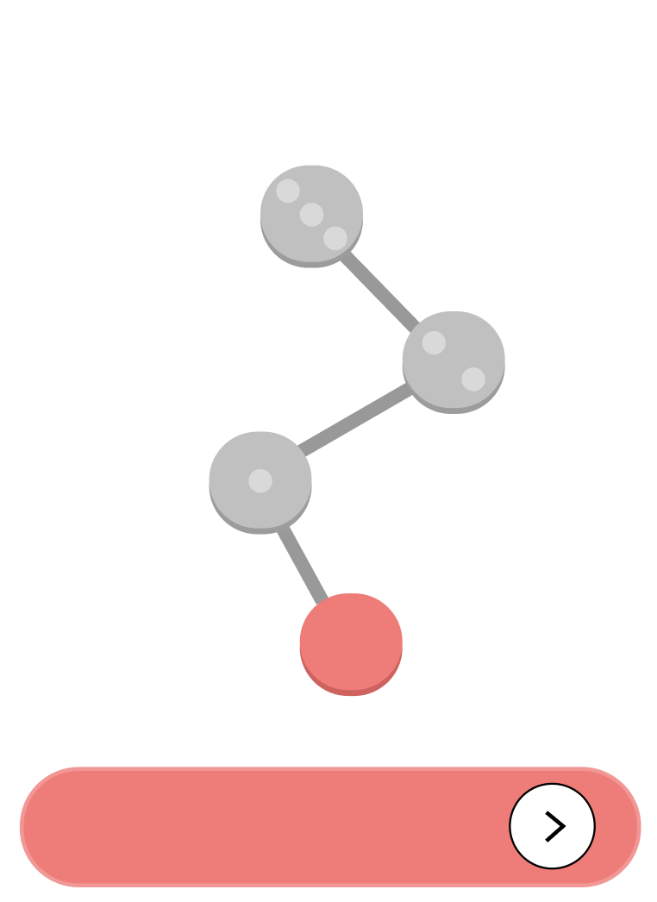
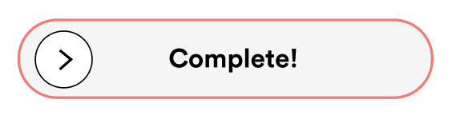
Medium Fidelity Prototyping…
ASSIGNMENT 6 Cecilia | Malina | Nazanin | Pedro

Slide 2
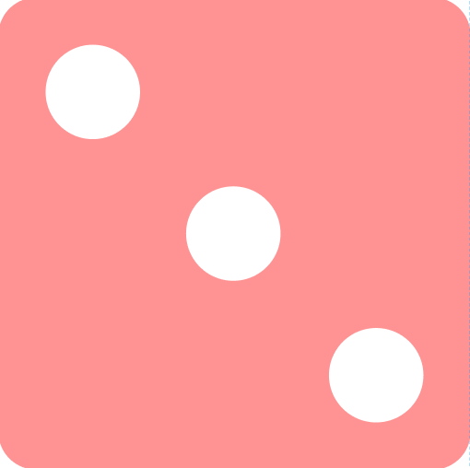
AGENDA
1 project intro
2 values in design
3 tasks
4 usability goals & key measurements
5 revised interface sketches
6 medium-fi task flows
7 prototype implementation

Slide 3

1
name and value proposition
TURNO

Slide 4


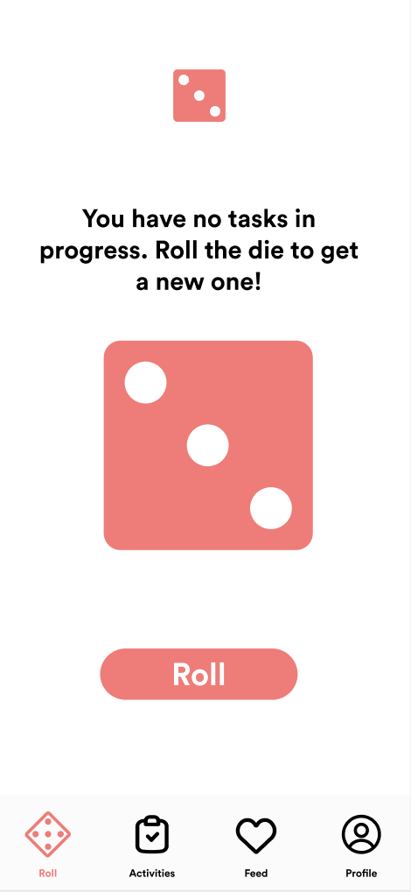
From the Portuguese word for shift, or round, and the idea of it being your turn. Turno. Your turn to roll the die and take agency of your life.
Game your tasks: Make every chore feel like a turn, not a toil.

Slide 5

there are daily obstacles preventing busy individuals from living an active lifestyle and accomplishing their goals — big or small.
turno allows users to input their activity goals, tasks to accomplish, & habits to build. Users roll the die to determine which of those tasks they should tackle, allowing them to overcome decision paralysis & establish long term habits.

Slide 6
2
values in design
TURNO
TURNO

Slide 7




MOTIVATION
INTEGRITY
PLAYFULNESS
one of our ultimate goals is to build motivation, using a mixture of extrinsic and intrinsic drivers.
we count with our user’s integrity and honesty in using the app, as it is essential for the success of our goal and theirs.
the app should be enjoyable to use. we want usability itself to be a motivator to get active!

Slide 8
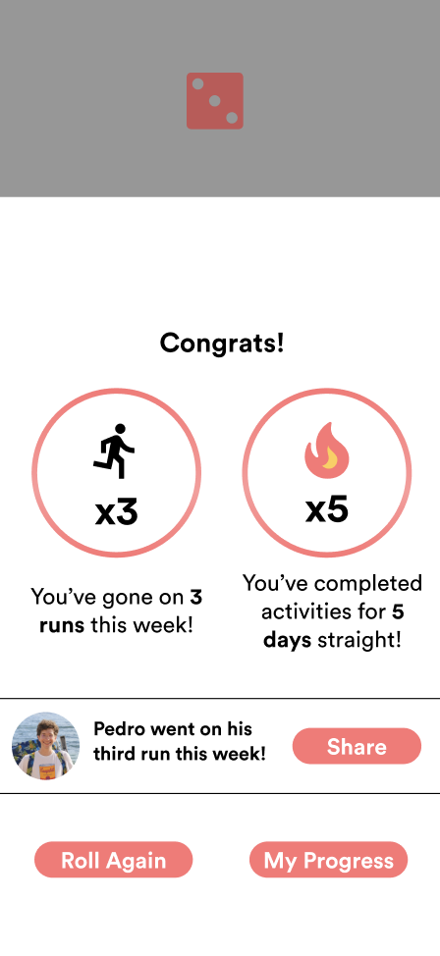
MOTIVATION
encoding motivation
Progress trackers
Encouraging messages upon completion
Social interactions (Kudos)
Streaks

Slide 9
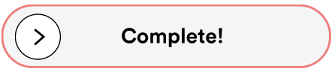
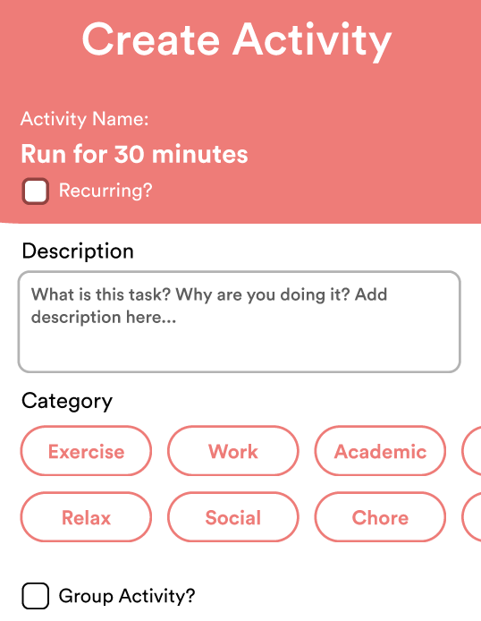
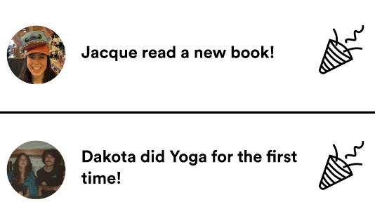
encoding integrity
INTEGRITY
Sliding the bar to mark activity as “complete”
Setting achievable goals/tasks
Integrity in sharing posts and interacting with friends (through “kudos”)

Slide 10
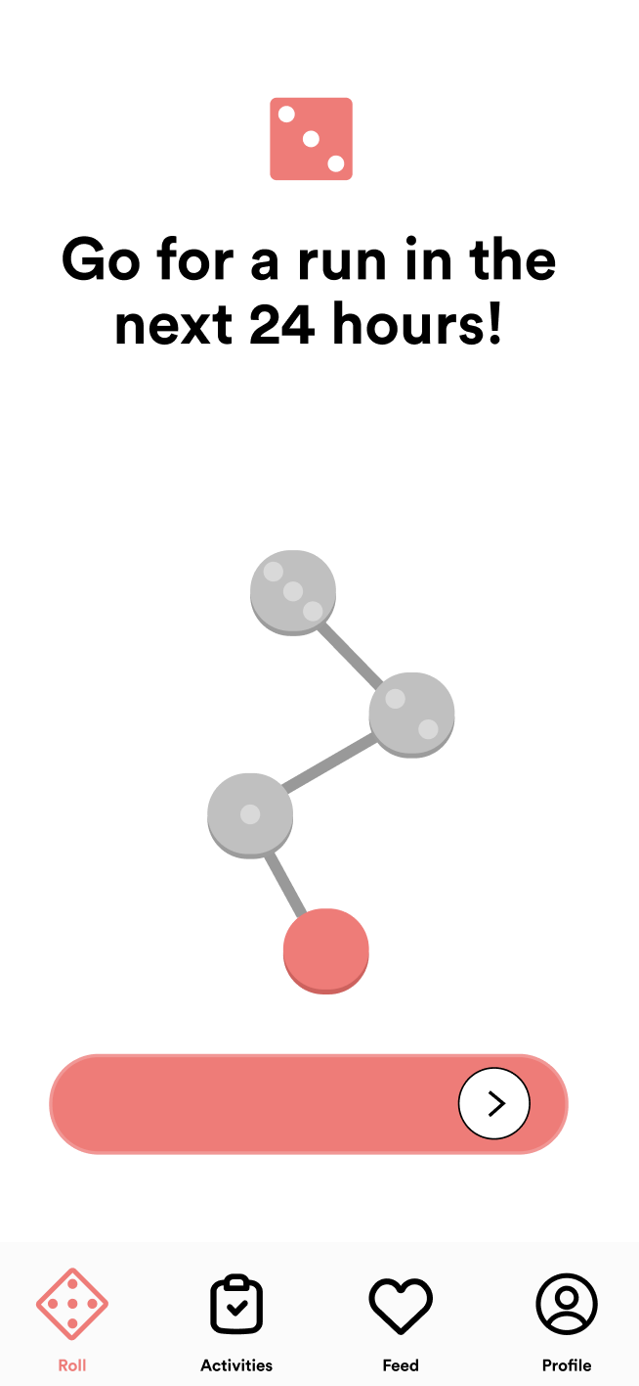
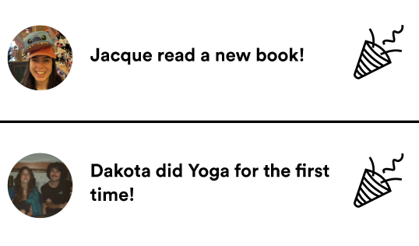
encoding playfulness
PLAYFULNESS
Die tool to resemble playing a game.
Board-game like page when task is complete
Social feed that enables interactions (kudos)
Group tasks with friends

Slide 11
value tensions emerging from design decisions
TURNO

Slide 12
MOTIVATION
INTEGRITY
PLAYFULNESS
Value tensions:
Streaks can increase motivation but hinder playfulness.
“Done” button challenges user’s integrity.
Playfulness can clash with motivation: “fun” is low-stakes.
Social validation (feed) creates tensions with intrinsic motivation
x
x

Slide 13
3
tasks and changes
TURNO

Slide 14
1.1: Complete an Activity #simple
1.2: Share the news with friends #simple
2.1: Create a new activity #moderate
2.2: Check your activities progress and statistics* #moderate
3: Create a group activity and invite friends to complete it with you #complex

Slide 15
4
usability goals and key measurements
TURNO

Slide 16
Usability Goals and Key Metrics
Pleasing: NPS and how likely the user would be to recommend the app (1-10).
User testing gave us an NPS of 5
Efficient: Number of service tickets, measured as number of “mis-clicks” or questions asked.
We measured 4 mis-clicks and were asked 6 clarifying questions across 4 tests

Slide 17
Improving Key Measurement Metrics
Pleasing
Added encouraging messages throughout (e.g. streaks, calendars)
Enabled more granular progress tracking for overall tasks but also each task (e.g. setting status as current, in progress, or completed)
Simplified task pages (minimized buttons and clicks required)
Provided more exit opportunities (e.g. exit and back buttons)

Slide 18
Improving Key Measurement Metrics
Efficient
Made button placements intentional and placed key factors in center frame
Used sizing intentionally, making individual tasks larger and visible
Streamlined task creation through one interface to reduce complexity

Slide 19
5
revised interface sketching
TURNO

Slide 20
major change #1
Completing + sharing an activity
New sliding button for completing a task
Removed option to DM
Added option to “roll again” to return home
TURNO

Slide 21
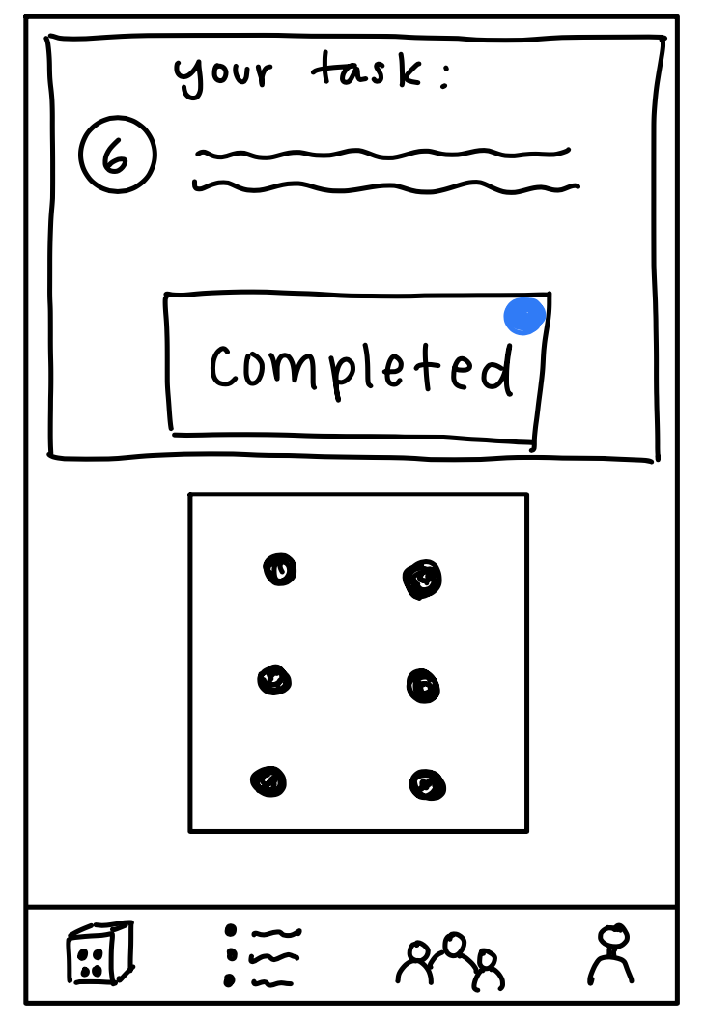
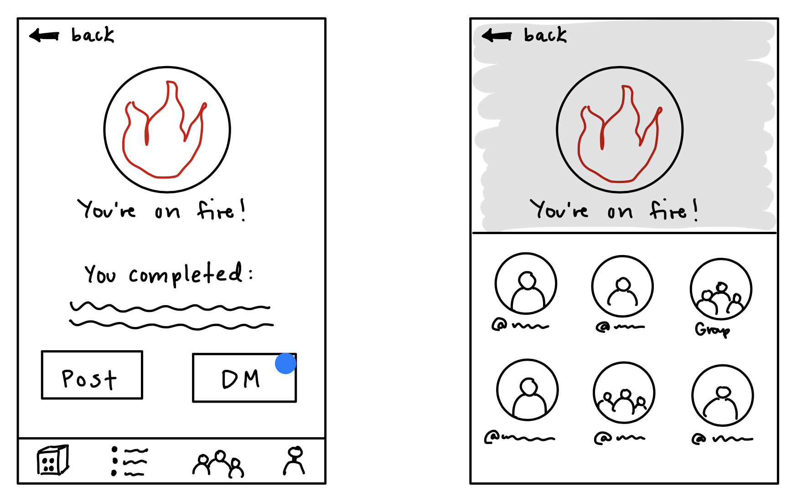
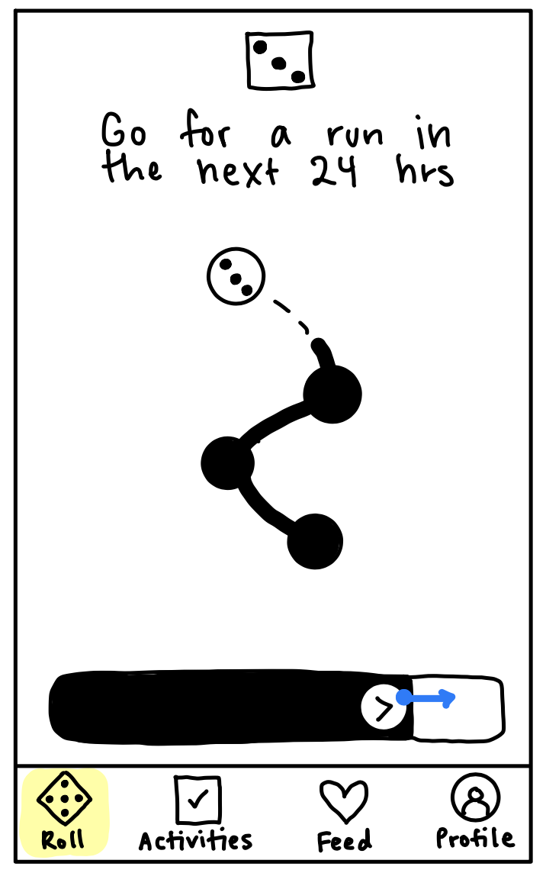
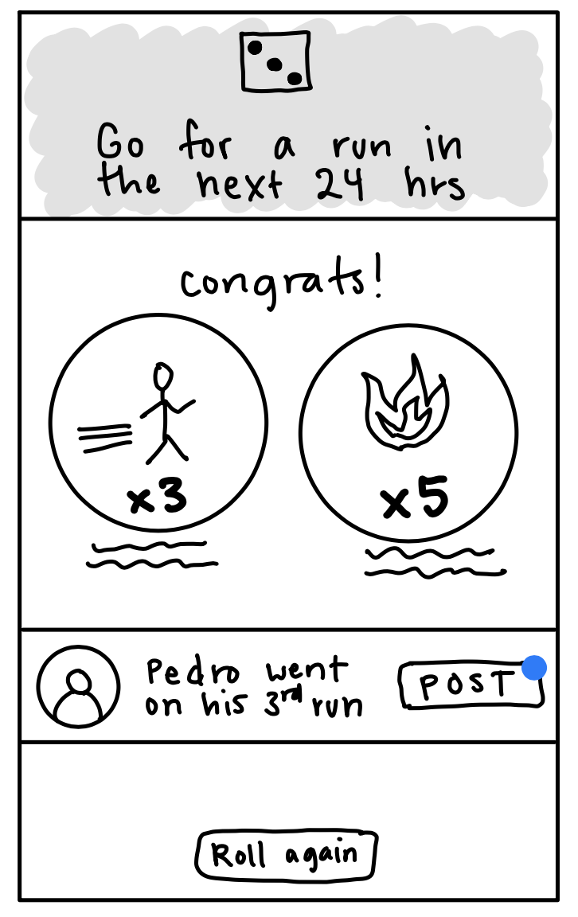
Before
After

Slide 22
major change #1
Improvements to usability goals:
More efficient: simplifies sharing process by removing DM feature (not core to our app’s goals), which should reduce misclicks
More pleasing: previous UI implied “post” and “DM” were requirements, which frustrated users who didn’t want to share. This change should increase NPS
TURNO

Slide 23
major change #1
Rationale for change:
Sliding “completed” button increases integrity from previous “done” button
Lo-fi prototype testing revealed users wanted a clearer option to NOT share the news of their activities
TURNO

Slide 24
major change #2
Adding a feed
Replaced our “groups and friends” page with a “feed” page, where users could see activities completed by their friends and send them a ‘kudos’
TURNO

Slide 25
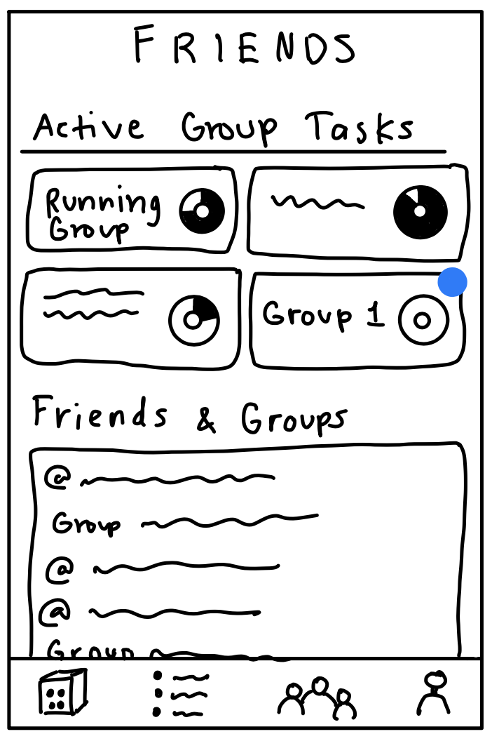
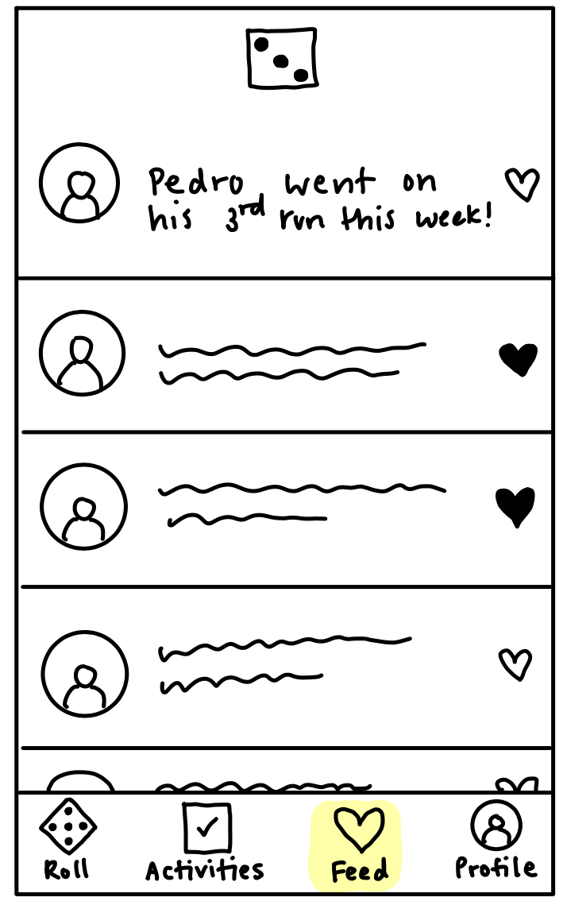
Before
After

Slide 26
major change #2
Improvements to usability goals:
By adding a feed and remove the groups page, we simplified the page layout, improving the efficiency of use, reducing mis-clicks and questions.
We also added a social interaction feature to give/receive ‘kudos’, to improve the user satisfaction and NPS score.
TURNO

Slide 27
major change #2
Rationale for change:
Users were confused by the purpose and complexity of our group task page, and required guidance to create and view group tasks.
Experience prototype showed that users wanted to be able to see their friends’ progress in a succinct way.
Users wanted to interact with their friends’ activity updates.
TURNO

Slide 28
major change #3
Creating a task + tasks page
More details when creating an activity (description, whether you want this recur, etc)
Less cluttered tasks page
TURNO

Slide 29
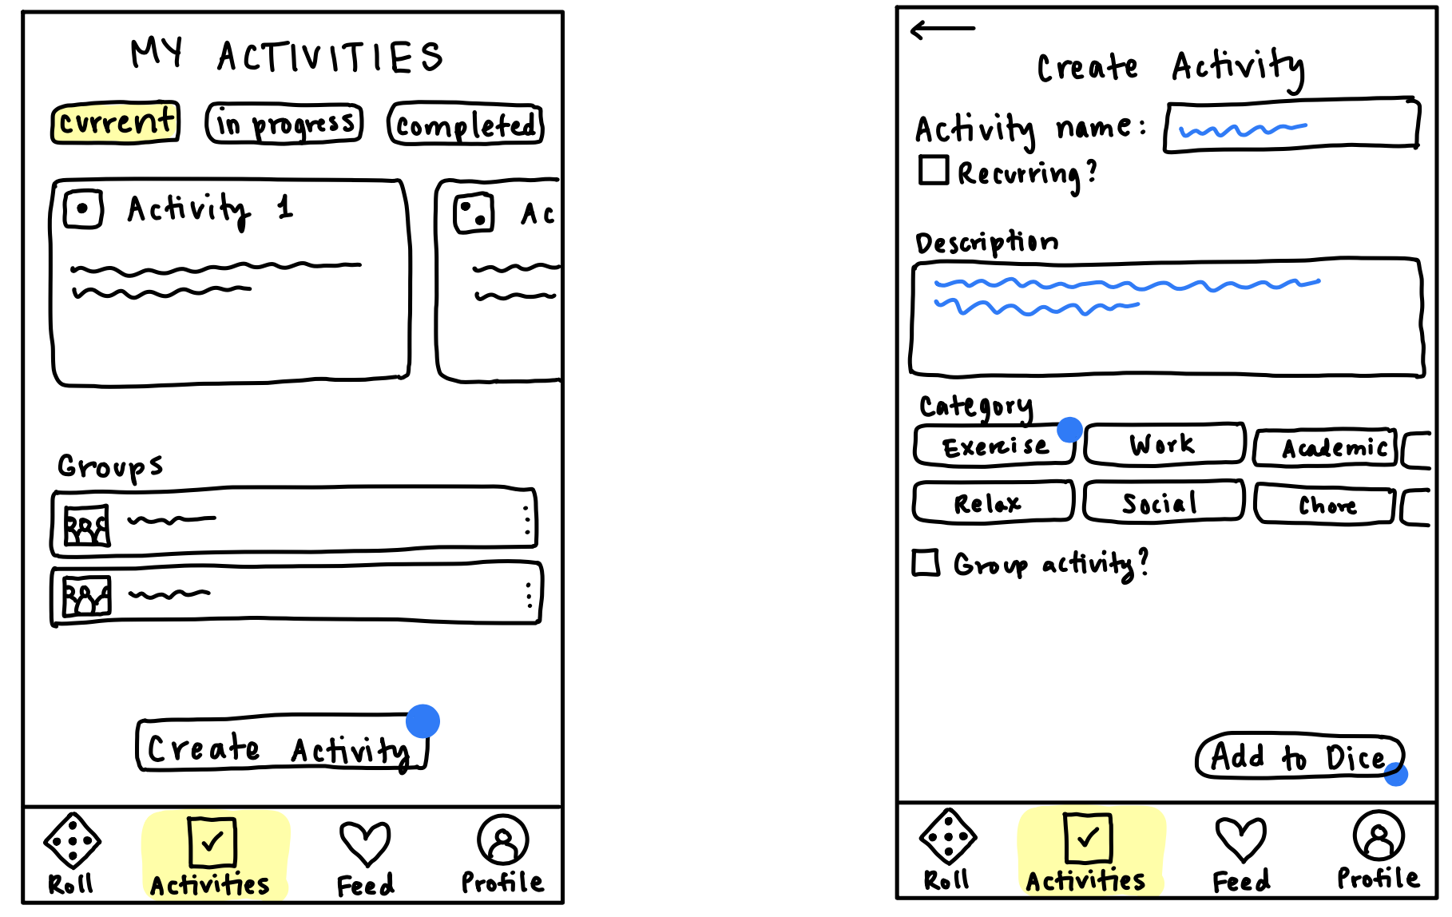
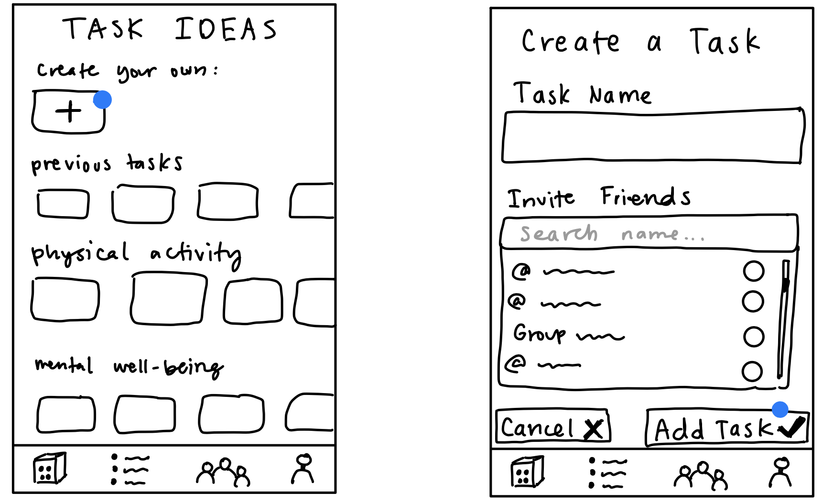
Before
After

Slide 30
major change #3
Improvements to usability goals:
Increases efficiency by adding group tasks on the same page as individual tasks, which should reduce misclicks by reducing the number of steps for the user.
UI is more pleasing (which should increase NPS) because users can see all their tasks on one page
TURNO

Slide 31
major change #3
Rationale for change:
“Task ideas” page was cluttered and confusing for users during our lo-fi prototype testing
We found it confusing that individual and group tasks were on different pages
TURNO

Slide 32
6
medium task-flows
TURNO

Slide 33
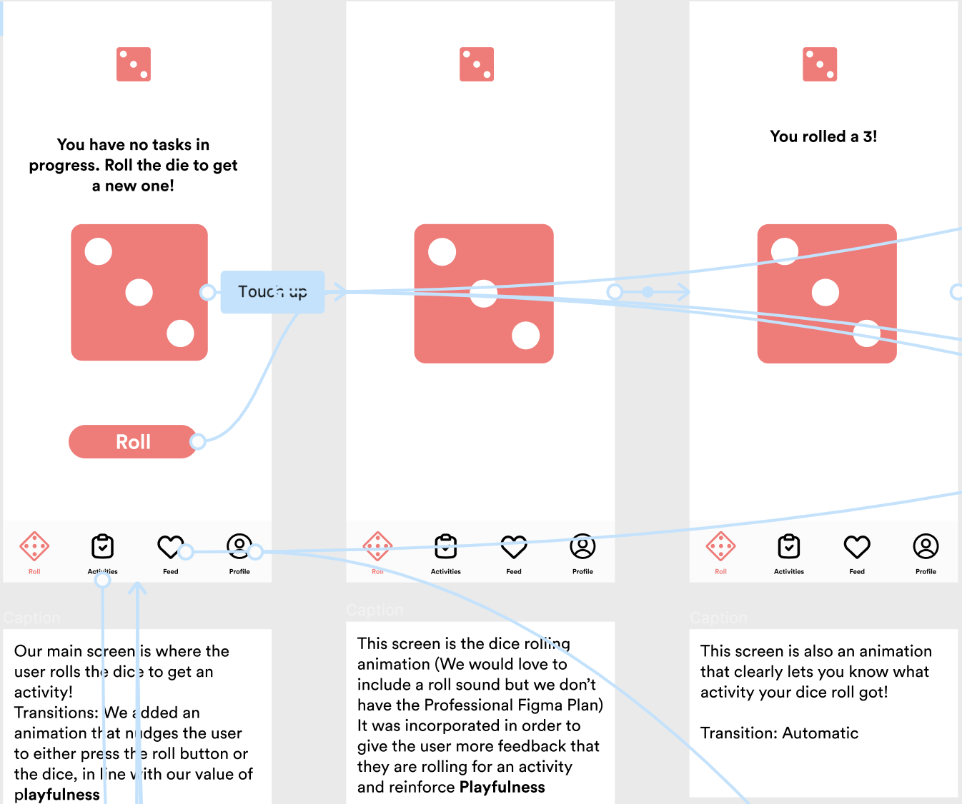
Simple
Complete an Activity

Slide 34
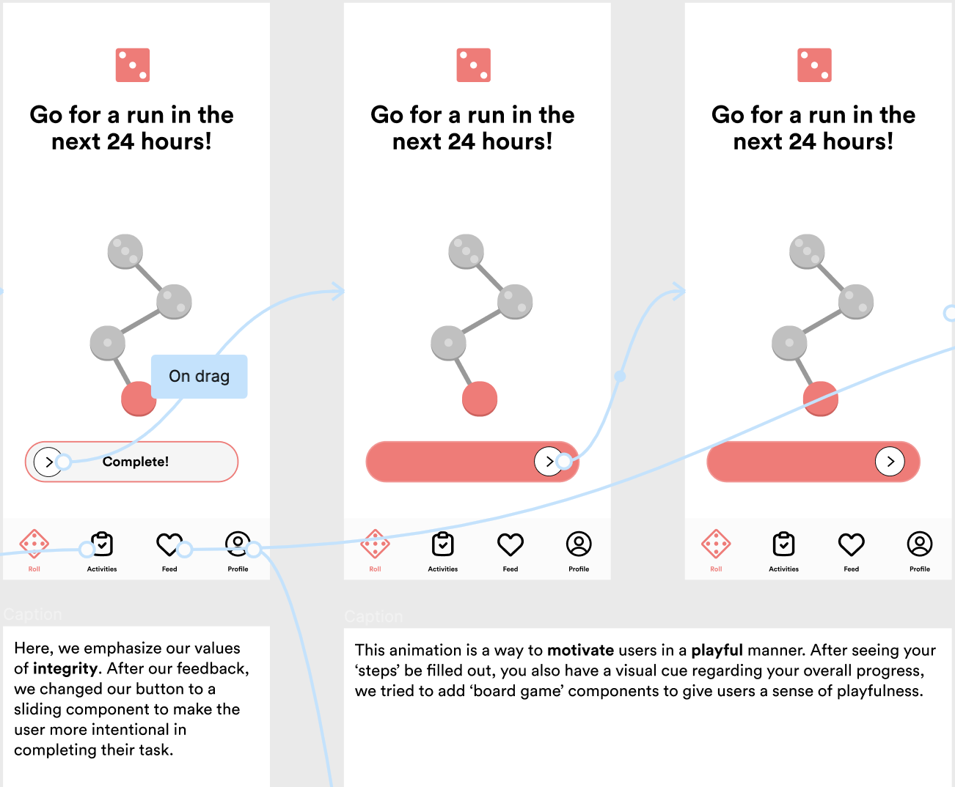
Simple
Share the news with friends

Slide 35
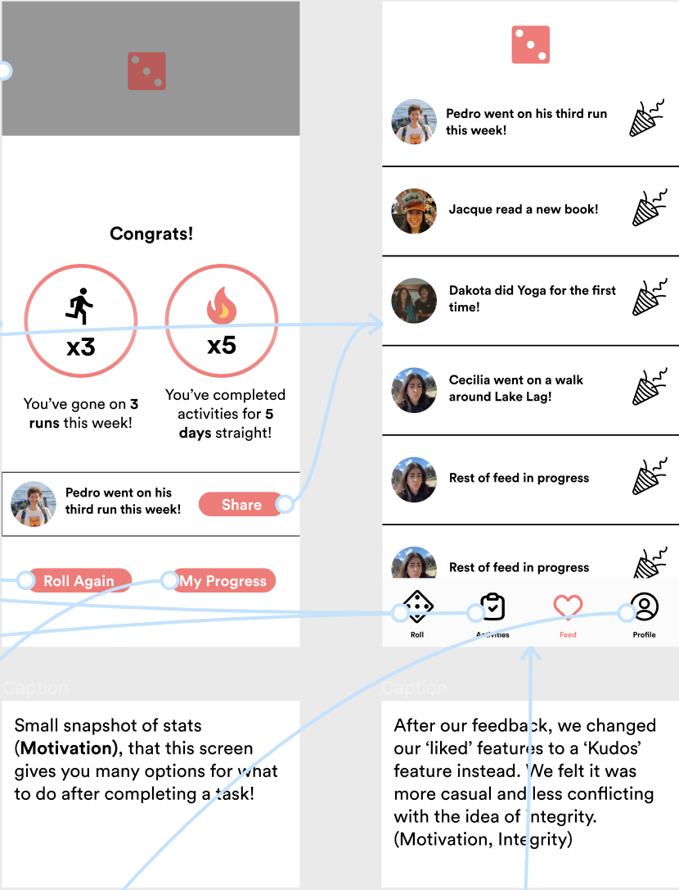
Simple
Share the news with friends

Slide 36
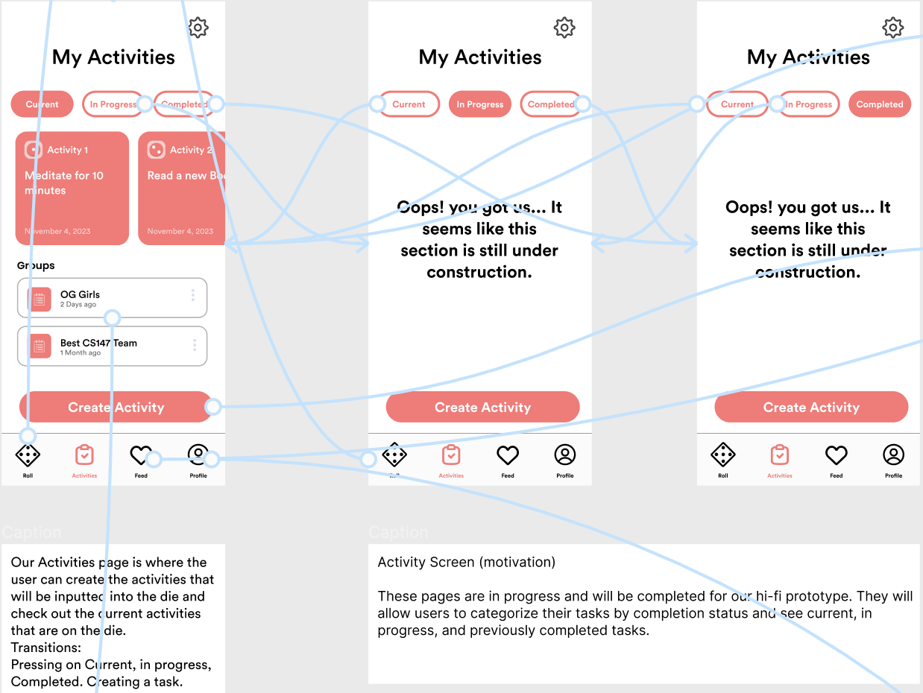
Moderate
Create a new activity

Slide 37
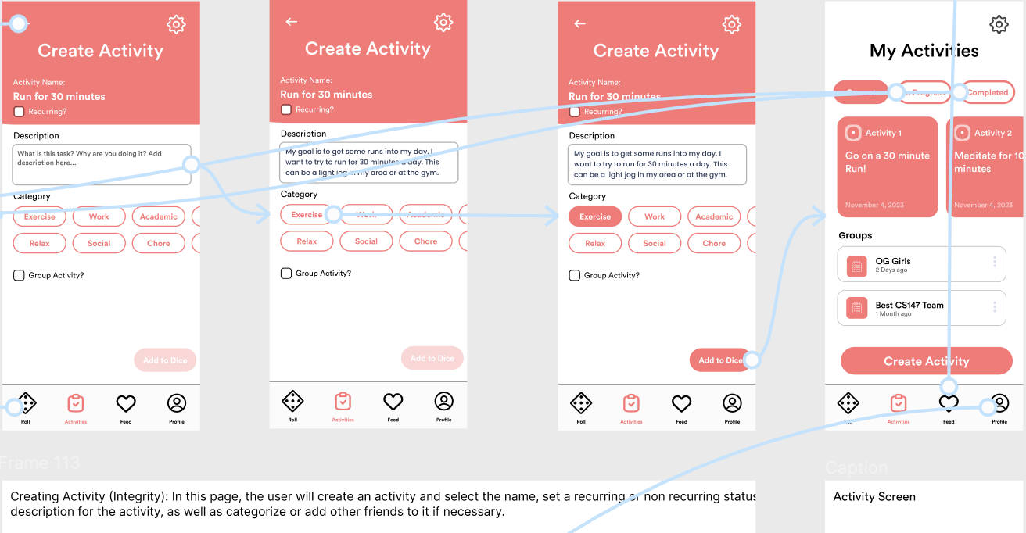
Moderate

Slide 38
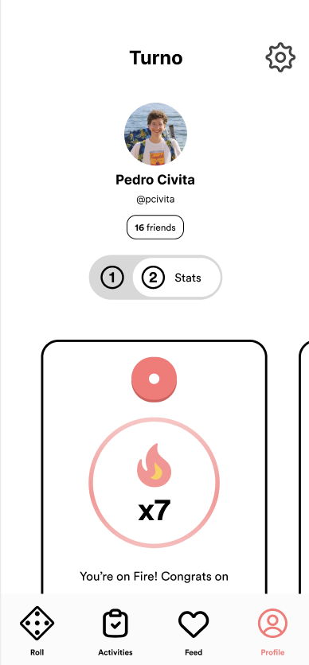
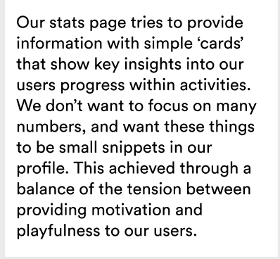
Moderate
Check your activities progress and statistics

Slide 39
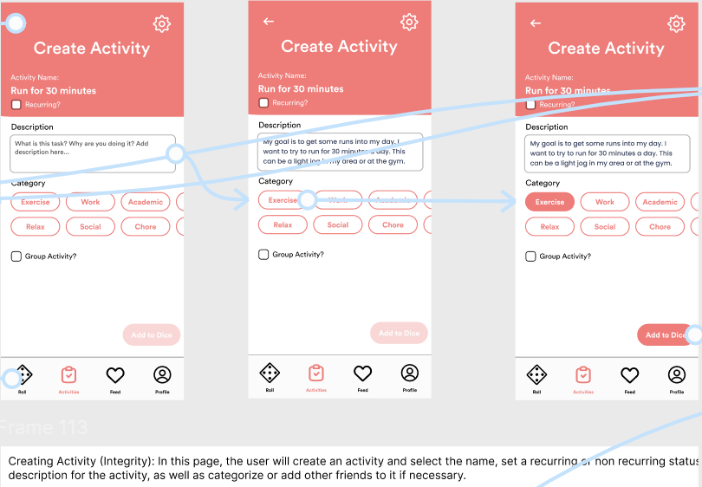
Complex
Create a group activity and invite friends to complete it with you

Slide 40
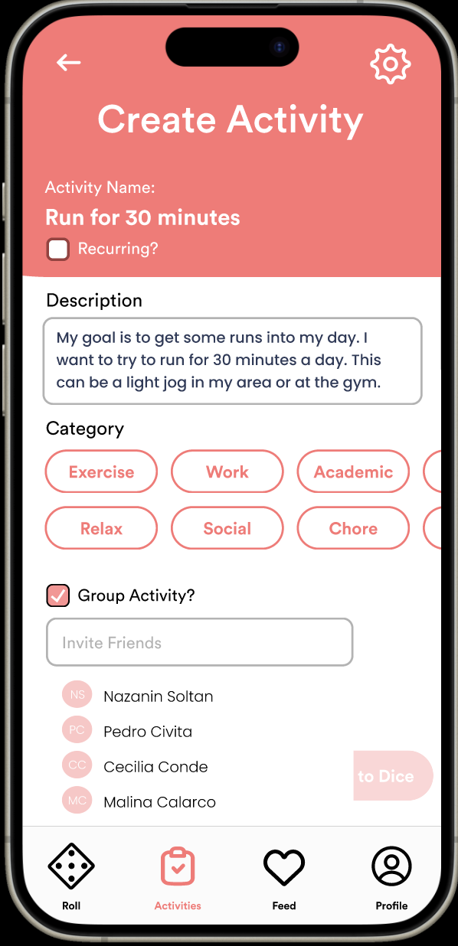
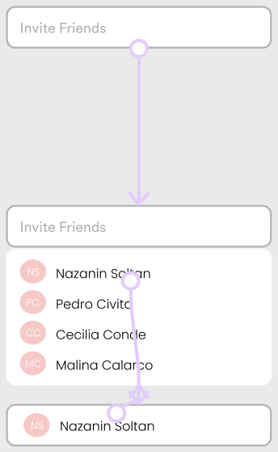
Complex
Create a group activity and invite friends to complete it with you

Slide 41
7
prototype implementation
TURNO

Slide 42
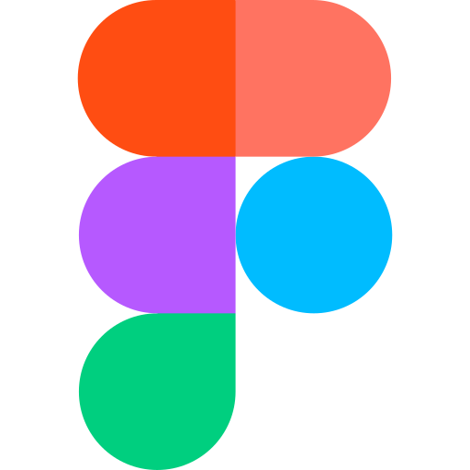
design and prototyping tools
for prototype development and design mockups, we used Figma
pros:
● easy collaboration
● grid systems for alignment and components
easy to be diligent with details; zoomable
cons:
● higher-stakes: difficult to delete elements/retract ideas
difficult learning curve for beginners
● prototype transitions make changes more complicated
● does not store memory

Slide 43

design and prototyping tools
for initial sketching of task flows and screens, we used GoodNotes
pros:
● simple, intuitive, we're used to it
● creative freedom
● very low-fi/low-stakes: encourages new iterations
cons:
● individual designs and wireframing – hard to collaborate in.

Slide 44
limitations
hard coded / wizard of oz
1. We have limited the number of clickable/scrollable options on a screen to only those enough to complete our tasks.
2. didn't include a full-fledged social network (as mimicked on the feed)
3. limited the scope of activities and categories
4. we didn't flesh out privacy permissions which we will add to settings.
1. dice rolling / randomization (is actually simulated; you always get a 3!)
2. feed page is hard-coded (no friends for now 😔)
3. the activities (and the description of activity, friends added to the activity), the activity groups are all hard-coded
4. user info in profile page is based on nothing but out intuition of Pedro's goals and stats <3

Slide 45
thank you
TURNO

Slide 46
Appendix
Med-Fi Figma: https://www.figma.com/file/RDkSKAbDRIfpmg8ZrJzkEM/A6-Turno-Med-Fi-Prototype?type=design&node-id=1%3A451&mode=design&t=FAz1ei0OZ3Gywtxx-1
Revised Lo-Fi Figma:
https://www.figma.com/file/lqnYB1K5xcnniqVhmOUSUP/Low-Fi-Storyboard?type=design&node-id=5-2&mode=design&t=uueqVhigLgHRRT6I-0
ReadMe: (in drive)

